Slide 1
ISO 14001 Overview Presentation

Slide 2
ISO 14001 Environmental Management System
INTRODUCTION TO ISO 14001
There is now an ever-increasing focus on global environmental concerns and any good business is very aware of the importance of good environmental management practices and compliance.
The ‘ISO 14001 Environmental Management Systems’ Standard provides businesses with a framework to protect the environment, reduce industrial waste and limit their impact on the environment. It specifies requirements that enable a business to achieve the intended outcomes that it sets for its environmental management system.

Slide 3
ISO 14001 Environmental Management System
PRESENTATION OVERVIEW
WHAT IS THE ISO 14001 STANDARD? WHAT IS AN ENVIRONMENTAL MANAGEMENT SYSTEM? THE ISO 14001 PLAN, DO, CHECK, ACT APPROACH CONTEXT OF THE ORGANIZATION LEADERSHIP PLANNING SUPPORT OPERATIONS | PERFORMANCE EVALUATION IMPROVEMENT THE KEYS TO ISO 14001 SUCCESS ISO 14001 BENEFITS ISO 14001 CHALLENGES YOUR ROLE WITH ISO 14001 IN CONCLUSION QUESTIONS
This presentation will help you to better understand the core ISO 14001 processes, so that we — ‘THE TEAM’— can achieve our intended environmental outcomes.

Slide 4
ISO 14001 Environmental Management System
WHAT IS THE ISO 14001 STANDARD
ISO 14001 is the International Standard for Environmental Management Systems
ISO 14001 is recognized and implemented worldwide.
ISO 14001 specifies the requirements for an Environmental Management System that a business can use to enhance its environmental performance.
The intent of ISO 14001 is to enable a business to identify and control the environmental impacts of its activities, products and services.

Slide 5
ISO 14001 Environmental Management System
WHAT IS AN EMS?
An Environmental Management System (EMS) specifies the framework in which a business manages environmental aspects and impacts.
An Environmental Management System is a set of processes that enable a business to increase its environmental efficiency.
An Environmental Management System is a coordinated and systematic approach to managing environmental risks and opportunities.
An Environmental Management System characterizes a set of policies, procedures, processes, plans and practices for managing risks and enables a business to meet all environmental legal obligations.

Slide 6
ISO 14001 Environmental Management System
THE PLAN, DO, CHECK, ACT, APPROACH
The Plan, Do, Check, Act approach is the ISO 14001 methodology that is used to ensure that all actions are planned and checked before the action takes place, as outlined below:
PLAN | Establish the environmental objectives and processes necessary to deliver the results in accordance with the organization’s environmental policy.
DO | Implement the processes required to convert the inputs into the outputs, as planned.
CHECK | Monitor and measure the processes against the environmental policy, including its commitments, environmental objectives and operating criteria and report on the results.
ACT | Take actions to continually improve environmental performance to achieve the intended outcomes.

Slide 7
ISO 14001 Environmental Management System
CONTEXT OF THE ORGANIZATION
For ISO 14001, we need to determine the external and internal issues that are relevant and affect our ability to achieve the intended outcomes of our ISO 14001 Environmental Management System. This may include further defining and managing the environmental risks and opportunities of the below (internal and external) aspects:
Internal | External
Roles, accountabilities and activities | Customers
Workers | Markets and competition
Working conditions | Regulatory and statutory
Market share | Technological
Physical resources | Cultural and social
Performance | General public
Values and culture | Suppliers
Innovation and knowledge | Political influence
Wastes and energy use | Contractors

Slide 8
ISO 14001 Environmental Management System
TYPES OF ASPECTS AND IMPACTS
An assessment system should be used to identify the significance of each type of environmental aspect and its subsequent impact.
General Types of Environmental Aspects and Impacts
Using Raw Materials Energy Use Fuel Use Water Use Waste Generation Chemical Use Solid Wastes Noise, Odor, Radiation Emissions Wastewater Contaminants Increase Landfill BUSINESS ACTIVITIES
Using Raw Materials
BUSINESS ACTIVITIES
Solid Wastes
Energy Use
Noise, Odor, Radiation
Fuel Use
Emissions
Water Use
Wastewater
Chemical Use
Contaminants
Waste Generation
Increase Landfill

Slide 9
ISO 14001 Environmental Management System
LEADERSHIP
Leadership and worker participation are critical for the success of an ISO 14001 Environmental Management System and the successful achievement of the intended environmental outcomes.
Good leadership and worker involvement are essential for establishing the processes that are central to achieving our environmental policy goals, targets and objectives.

Slide 10
ISO 14001 Environmental Management System
PLANNING
Planning for ISO 14001 is an ongoing process, and this planning needs to anticipate changing circumstances when determining our environmental risks and opportunities.
Actions to Address Environmental Risks and Opportunities
Environmental Issues, Environmental Aspects
Risks and Opportunities Assessed
Enhance Intended Outcomes
Prevent Undesired Effects
Promote Opportunities
Drive Improvement
Compliance
Obligations
Mitigation Actions
Organizational Context and Interested Parties Expectations

Slide 11
ISO 14001 Environmental Management System
SUPPORT
An ISO 14001 Environmental Management System needs to have the required support and resources needed to achieve the desired outcomes. Support and resource allocation should be assessed during reviews and consider:
People.
Infrastructure.
Work environment.
Information.
Suppliers and partners.
Natural and financial resources.

Slide 12
ISO 14001 Environmental Management System
OPERATIONS
Operational planning and the control of processes is needed to implement and benefit from ISO 14001. Key aspects to deliver these environmental benefits may include:
Environmental design.
Environmental procurement planning.
Manufacturing planning.
Packaging, transport and delivery considerations.
Intended use with consideration to the environment.
End of life treatment and disposal.
Establishing preventive and/or predictive maintenance and inspection programs.
The application of legal requirements and compliance obligations, etc.

Slide 13
ISO 14001 Environmental Management System
LIFE CYCLE AND ENVIRONMENTAL REQUIREMENTS
Environmental Requirements
1. Design Phase
2. Procurement Phase
Environmental Requirements
Identify Relevant Environmental Aspects at Each Stage in The Products’ Life Cycle
6. End of Life Treatment and Disposal
3. Manufacturing Phase
Significant Environmental Impacts
5. Intended Use Phase
4. Packaging Transport and Delivery Phase
Customer Requirements

Slide 14
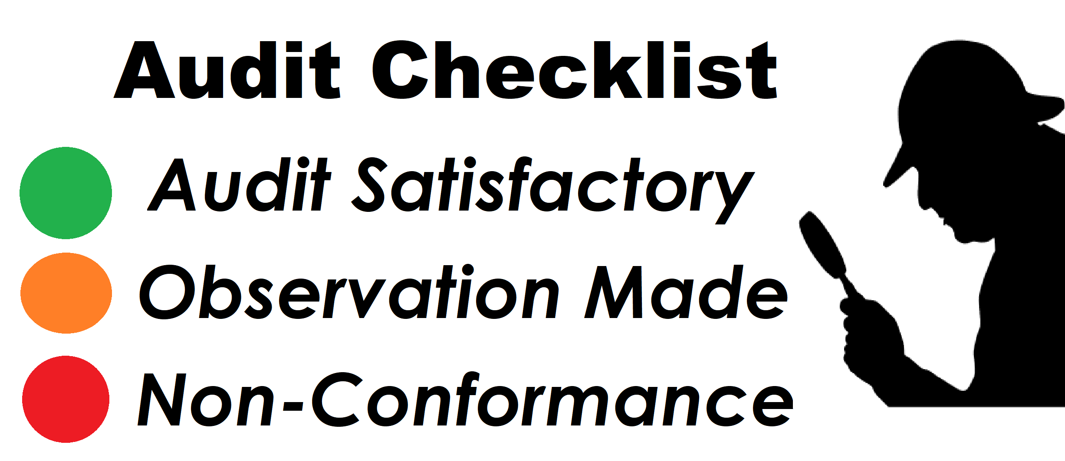
ISO 14001 Environmental Management System
PERFORMANCE EVALUATION
The frequency and methods by which processes are monitored, measured and evaluated may be determined and informed by:
Statutory and regulatory requirements.
Customer feedback and specification requirements.
Process and environmental management systems requirements.
Process performance and audit results.
Level of risk and types of control measure.
Trends in non-conformities or corrective actions.
Criticality for product conformity.
This also forms part of the continual improvement process.

Slide 15
ISO 14001 Environmental Management System
IMPROVEMENTS
ISO 14001 improvements can be gained by reviewing the results of environmental performance and this may include:
Environmental risk and opportunity evaluations.
Assessment of the changing needs and expectations of interested parties.
The effectiveness of the Environmental Management System.
Reducing or eliminating adverse environmental impacts.
Increasing beneficial effects and opportunities.
The levels of cost savings.
Internal and external audit results.

Slide 16
ISO 14001 Environmental Management System
KEY ELEMENTS TO ISO 14001 SUCCESS
There are some key elements that need to be considered to ensure the successful development and implementation of an ISO 14001 Environmental Management System, inclusive of:
Determining resource gaps.
Ensuring the support and commitment of management and the employees.
Maintaining a focus on the fundamentals such as the environmental policy and legal requirements.
Ensuring that everyone is aware of what is being done, why it’s being done and how it’s being done.
Regular communication and feedback on progress.
Progressing gradually and efficiently through the ISO 14001 Standard.

Slide 17
ISO 14001 Environmental Management System
THE BENEFITS OF ISO 14001
Some of the main benefits of having an ISO 14001 Environmental Management System include:
Improved environmental performance and compliance.
Pollution prevention and resource conservation.
Increased efficiency and reduced costs.
Enhanced employee morale.
Employee awareness of environmental issues and responsibilities.
Enhanced knowledge of environmental risks and opportunities.
An improved company image and reputation.
Improved cost control and financial benefits.
Additional business expansion possibilities.

Slide 18
ISO 14001 Environmental Management System
ISO 14001 CHALLENGES
There can also be challenges with the development and implementation of ISO 14001 Environmental Management System inclusive of:
Obtaining the awareness of ISO 14001 within the entire organization.
Having the resources and dedicated time needed for ISO 14001.
Interpreting the contextual requirements of ISO 14001.
Determining what needs to be documented.
Promoting continual improvement of the ISO 14001 Environmental Management System.

Slide 19
ISO 14001 Environmental Management System
YOUR ROLE ISO 14001
There are several things that you can do to make the ISO 14001 Environmental Management System work:
Know and understand the environmental policy and ISO 14001 environmental objectives.
Understand how you can contribute to the development and implementation of ISO 14001.
Know the environmental risks and opportunities that are relevant to your work.
Contribute to the ISO 14001 journey where you can.
Communicate environmental risks and opportunities relevant to your work.
Be considerate of others and assist wherever possible to enhance our environment.

Slide 20
ISO 14001 Environmental Management System
IN CONCLUSION
With everyone working together and all of our energy going in the same direction, we can successfully implement an ISO 14001 Environmental Management System that will create opportunities, improve your company and make your workplace (and the world) healthier and happier for everyone.

Slide 21
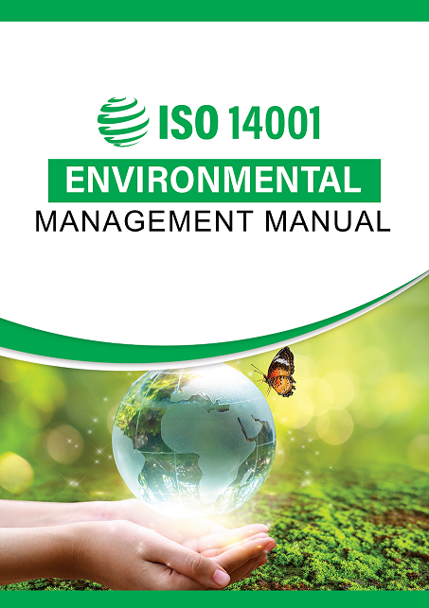
ISO 14001 Environmental Management System
QUESTIONS
Is there anything more you would like to know?

Slide 22
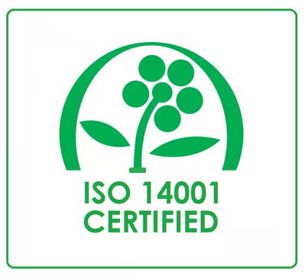
ISO 14001 Environmental Management System
THANK YOU FOR YOUR PARTICIPATION

